Slide 1
Playing Atari with Deep Reinforcement Learning
OYTUN GÜNEŞ, ÜMİTCAN ŞAHİN, ZAFER TOPÇUOĞLU

Slide 2
Illustration
https://www.youtube.com/watch?v=V1eYniJ0Rnk

Slide 3
Introduction
Deep Learning : extract high-level features from raw data.
Can Deep learning techniques RL (reinforcement learning) ?
There are challenges….

Slide 4
Challenges
RL needs to learn from rewards signal is rare, noisy and delayed ( Normally algorithms are provided a big-data)
States are correlated in RL. ( Normally samples are independent)
Data distribution changes as the algorithm learns ( Normally it is kept fixed)
Challenges can be overcome by using Convolutional Neural Networks.

Slide 5
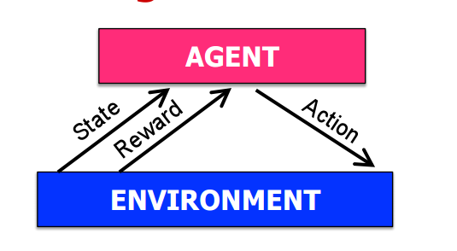
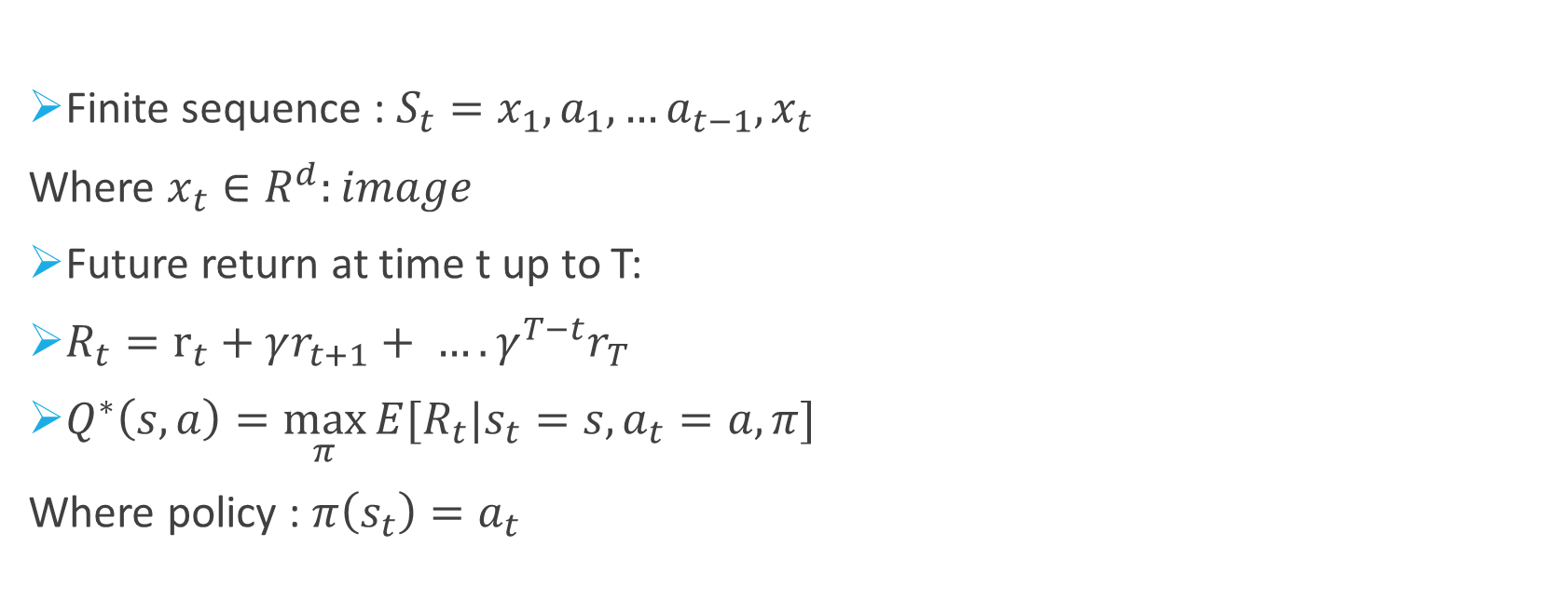
Reinforcement Learning
Finite sequence : $S_{t}=x_{1},a_{1},…a_{t−1},x_{t}$
Where $x_{t}∈R^{d}:image$
Future return at time t up to T:
$R_{t}=r_{t}+γr_{t+1}+ …. γ^{T−t}r_{T}$
$Q^{∗}\left(s,a\right)=\max_{π}{E[R_{t}|s_{t}=s,a_{t}=a,π] }$
Where policy : $π\left(s_{t}\right)=a_{t}$

Slide 6
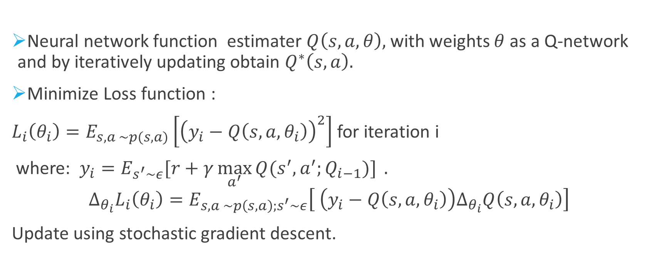
Q-Network function approximator
Neural network function estimater $Q\left(s,a,θ\right),$with weights $θ$ as a Q-network and by iteratively updating obtain $Q^{∗}\left(s,a\right).$
Minimize Loss function :
$L_{i}\left(θ_{i}\right)=E_{s,a \sim p(s,a)}\left[{\left(y_{i}−Q\left(s,a,θ_{i}\right)\right)}^{2}\right]$ for iteration i
where: $y_{i}=E_{s^{′}\sim ε}[r+γ\max_{a^{′}}{Q(s^{′},a^{′};Q_{i−1})] }.$
$$Δ_{θ_{i}}L_{i}\left(θ_{i}\right)=E_{s,a \sim p\left(s,a\right);s^{′}\sim ε}\left[ \left(y_{i}−Q\left(s,a,θ_{i}\right)\right)Δ_{θ_{i}}Q\left(s,a,θ_{i}\right)\right]$$
Update using stochastic gradient descent.

Slide 7
Related Work
Model-free vs Model-dependent Learning
In the former case, the environment is learned without actually estimating it. (e.g. Q-learning, TD, Monte Carlo)
Off-policy vs On-policy Learning:
In the former case, Q-values updated according to the Q-value of the next state s’ and greedy action a’ (BUT we do not follow the greedy action since we have to explore!)
In the latter case, a policy followed throughout and Q-values updated according to the actions taken by this policy
TD-gammon: A backgammon playing program
Model-free Q-learning with Temporal Differencing
V(s) – approximation with MLP with 1 hidden layer
Problem with the TD & MLP approach: Poor performance in chess, Go, checkers, etc. since full exploration of state space needed

Slide 8
Related Work
Previous work had shown that Q-values actually diverge if non-linear function approximators are used
This has been solved partially by the Gradient Temporal-Difference methods & Restricted Boltzmann machines
If a fixed policy is considered, Q-values shown to converge
Neural Fitted Q-learning (NFQ)
Weight updates using the RPROP algorithm
Purely visual input
Use of auto-encoders to learn a low dimensional representation of the task
Problem: Computational cost proportional to the size of the dataset

Slide 9
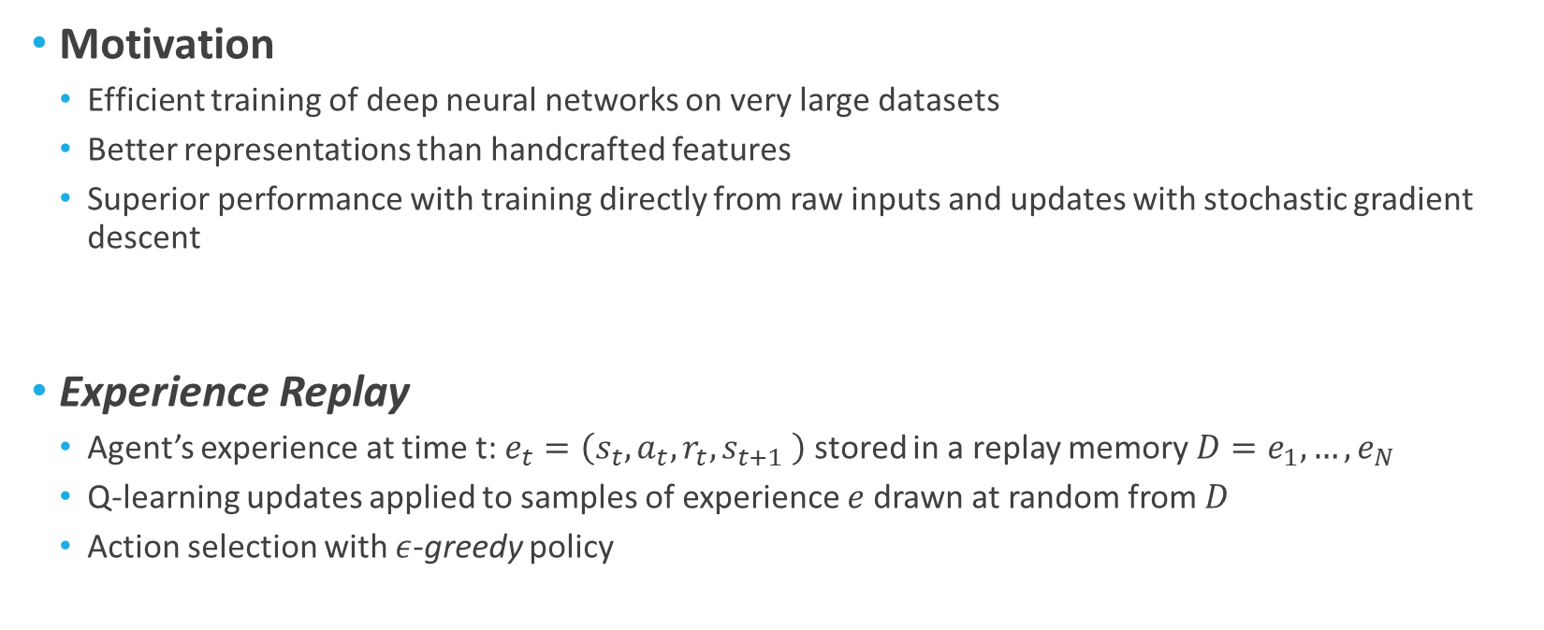
Deep Reinforcement Learning
Motivation
Efficient training of deep neural networks on very large datasets
Better representations than handcrafted features
Superior performance with training directly from raw inputs and updates with stochastic gradient descent
Experience Replay
Agent’s experience at time t: $e_{t}=\left(s_{t}, a_{t}, r_{t}, s_{t+1} \right)$ stored in a replay memory $D=e_{1}, …, e_{N}$
Q-learning updates applied to samples of experience $e$drawn at random from $D$
Action selection with $ε$-greedy policy

Slide 10
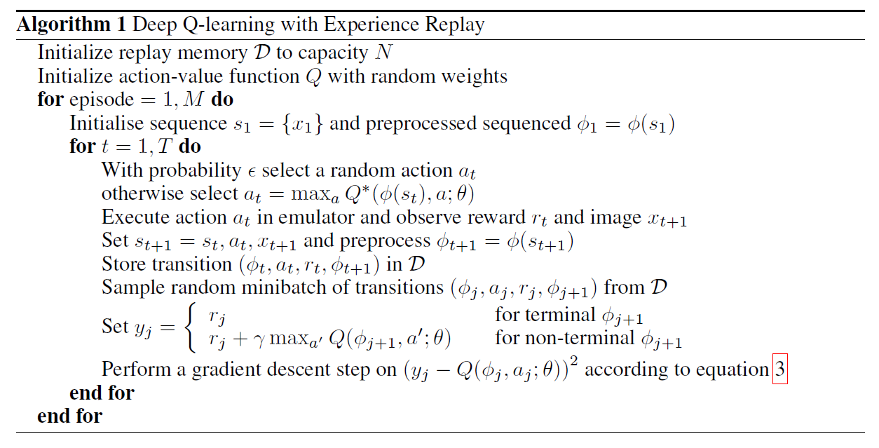
Deep Reinforcement Learning
1
2
3
4
5
6
7
8
9
10
11
12

Slide 11
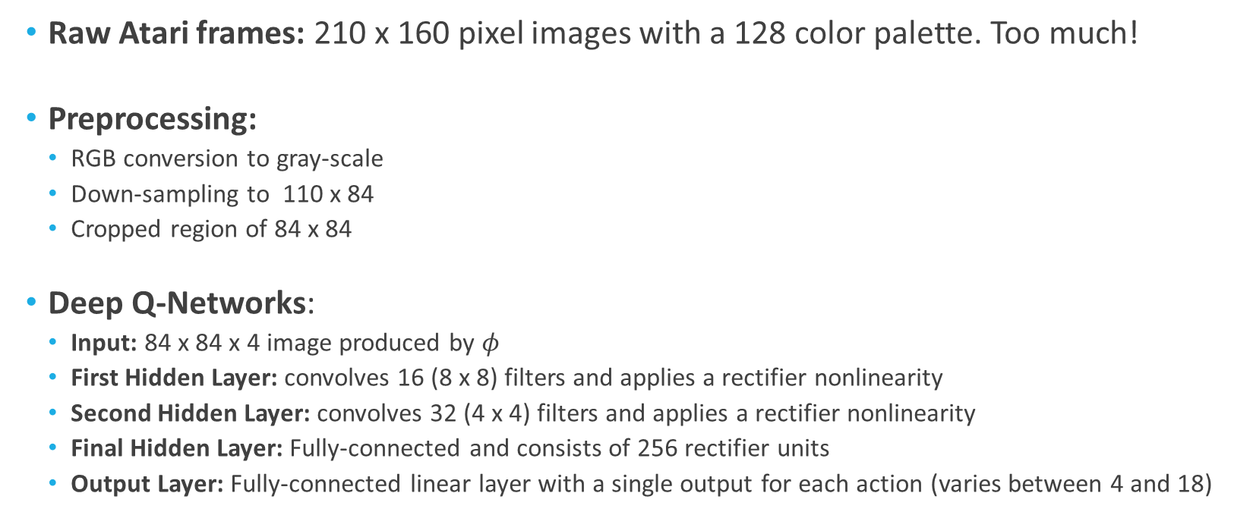
Preprocessing and Model Architecture
Raw Atari frames: 210 x 160 pixel images with a 128 color palette. Too much!
Preprocessing:
RGB conversion to gray-scale
Down-sampling to 110 x 84
Cropped region of 84 x 84
Deep Q-Networks:
Input: 84 x 84 x 4 image produced by $φ$
First Hidden Layer: convolves 16 (8 x 8) filters and applies a rectifier nonlinearity
Second Hidden Layer: convolves 32 (4 x 4) filters and applies a rectifier nonlinearity
Final Hidden Layer: Fully-connected and consists of 256 rectifier units
Output Layer: Fully-connected linear layer with a single output for each action (varies between 4 and 18)

Slide 12
Strong Weak Points
Strong: Very effective since it outperformed 6 algorithms.
Weak:
Didn’t state how they choose sequences.

Slide 13
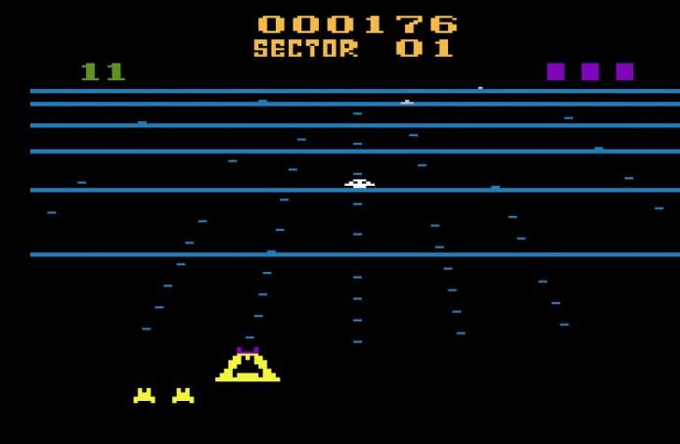
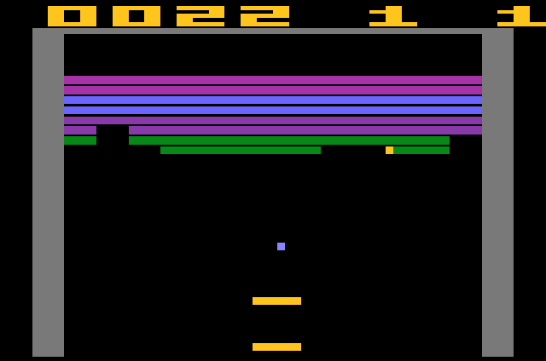
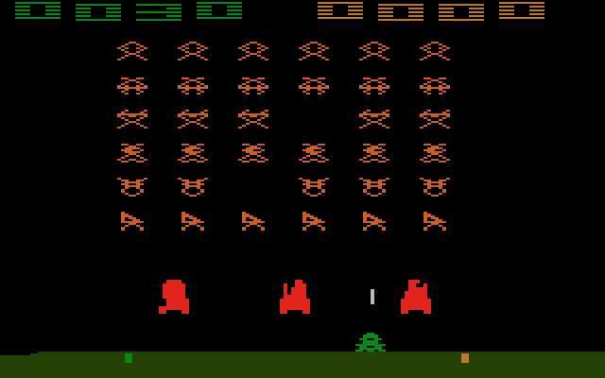
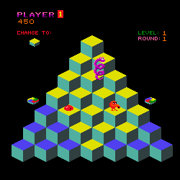
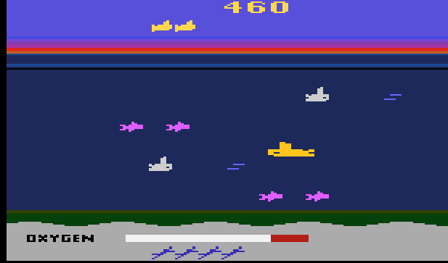
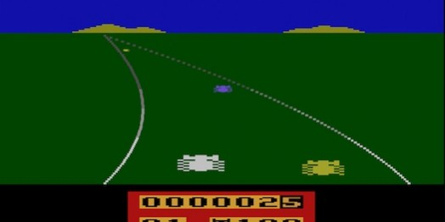
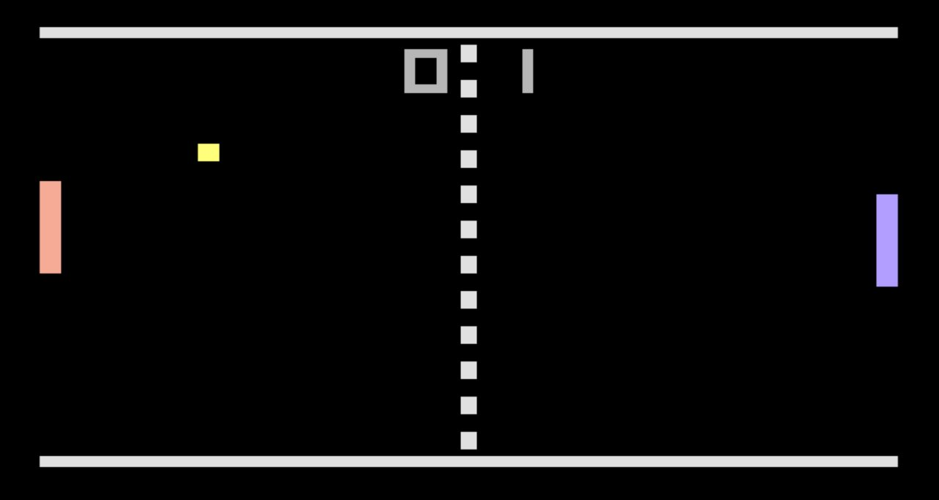
Experiments

Slide 14
Experiments
Same network architecture, learning algorithm and hyperparameters
to show this approach is robust and work on a variety of games without any specific information
real and unmodified games
Only reward structure changed during the training
+1 to positive rewards, -1 to negative rewards, 0 to unchanged rewards
limits the scale of the error derivatives
makes it easier to use the same learning rate across all games
affect the performance of the agent since it cannot differentiate between rewards of different magnitude

Slide 15
Experiments
RMSProp algorithm with minibatches of size 32
ε-greedy with ε annealed linearly from 1 to 0.1 over the first million frames
fixed at 0.1 after first million frames
total 10 million frames and used replay memory of one million most recent frames
Simple frame-skipping technique
sees and selects actions on every k-th frame instead of every frame
last action repeated on skipped frames
k times more games without increasing the runtime
k = 4 (in Space Invaders k=3)

Slide 16
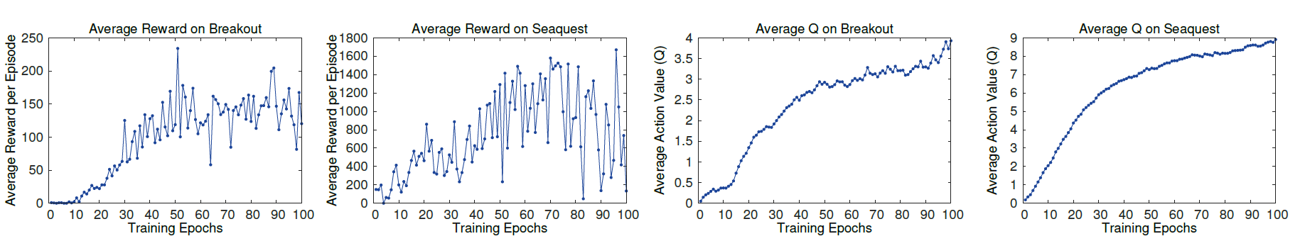
Training and Stability
Evaluation metric is the total reward the agent collects in an episode or game averaged over a number of games
Computed periodically during training
Average total reward metric tends to be very noisy
Small changes to the weights causes large changes in the distribution of states

Slide 17
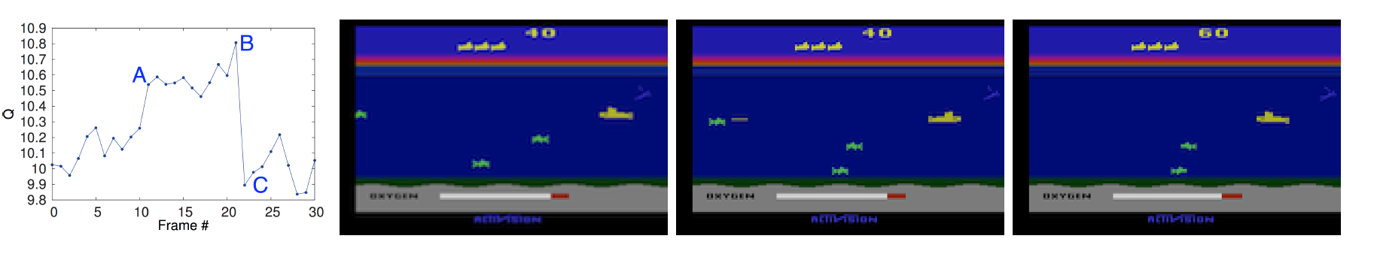
Visualizing the Value Function
Visualization of the learned value function on the game Seaquest
Predicted value jumps when an enemy appears (A)
Agent fires a torpedo at the enemy (B)
Enemy disappears (C)

Slide 18
Main Evaluation
Results compared with the best performing methods from the RL literature
Sarsa algorithm to learn linear policies on several different feature sets hand-engineered for the Atari task
Contingency uses same basic approach as Sarsa but augmented the feature sets with a learned representation of the parts of the screen that under the agent’s control.
Both incorporate significant prior knowledge about the visual problem by using background subtraction and treating each of the 128 colors as a separate channel.
Atari uses one distinct color for each type of object and treating each color as a separate channel is similar to the binary map encoding the presence of each object type

Slide 19
Main Evaluation
Agents in paper only receive the raw RGB screenshots as input and must learn to detect object on their own.
Expert human game player result also recorded
Median reward achieved after around two hours playing each game
For learned methods, evaluation strategy used as Bellemare used
Report the average score obtained by running and ε-greedy policy with ε=0.05 for a fixed number of steps
HNeat Best score reflects the results obtained by using a hand-engineered object detector algorithm that outputs the locations and types of objects
Hneat Pixel score is obtained by using the special 8 color channel representation of the Atari emulator that represents an object label map at each channel.

Slide 20
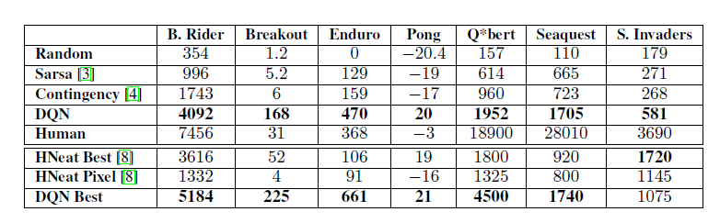
Comparison

Slide 21
Conclusion
New deep learning model for RL is introduced
For Atari 2600 games, methods ability is demonstrated using only raw pixels as input
Variant of online Q-learning which combines stochastic minibatch updates with experience replay memory to ease the training of deep networks for RL is represented
Without adjustment of the parameters or architecture, this approach gave state of the art result

Slide 22
References
Marc G Bellemare, Yavar Naddaf, Joel Veness, and Michael Bowling. The arcade learning environment: An evaluation platform for general agents. Journal of Artificial Intelligence Research, 47:253–279, 2013.
Marc G Bellemare, Joel Veness, and Michael Bowling. Investigating contingency awareness
using atari 2600 games. In AAAI, 2012
Christopher JCH Watkins and Peter Dayan. Q-learning. Machine learning, 8(3-4):279–292, 1992.

